Slide 1
Data analysis on 15 top destinations in Malaysia
Syuria Amirrudin

Slide 2

Data
The data consists of 15 rows and 6 columns.
The column represents 6 variables we are going to look into for each destinations.
While the 15 rows represent 15 destinations with the details.

Slide 3
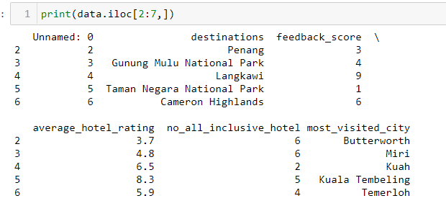
Example of the destinations
6 out of 15 top destinations in Malaysia

Slide 4
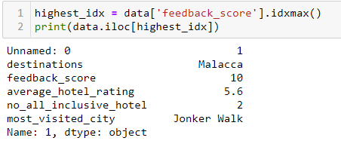
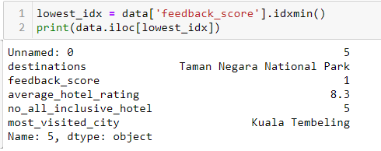
The feedback score of the destinations
The lowest feedback scoring is 1 which the destination is Taman Negara National Park.
The highest feedback scoring is 10 which the destination is Malacca.

Slide 5
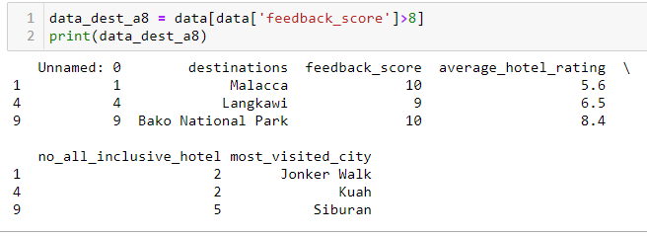
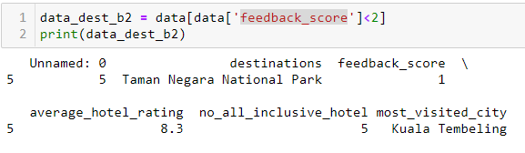
The feedback score of the destinations
There are 3 destinations with feedback score more than 8.
There is 1 destination with feedback score less than 2.

Slide 6

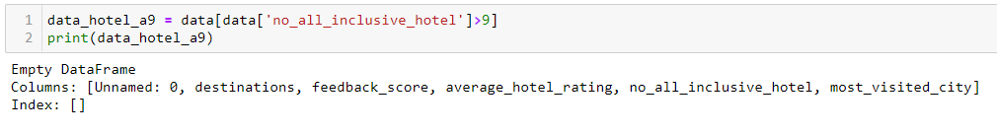
All-inclusive hotel
The average of the number of all-inclusive hotel in these 15 destinations is 4.
In all 15 destinations, the number of all-inclusive hotel is not more than 9 in total.

Slide 7
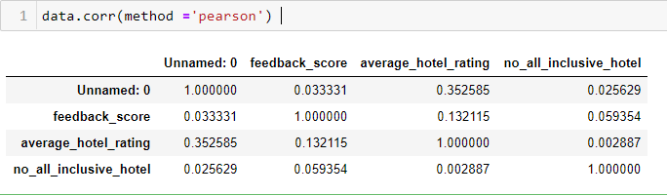
The correlation between number of all-inclusive hotel and feedback score.
There is no significant correlation between these two variables: number of all-inclusive and feedback score.

Slide 8
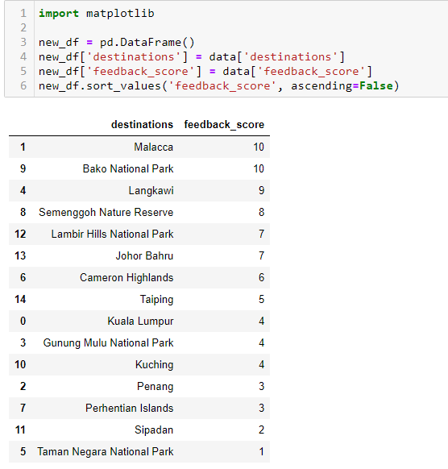
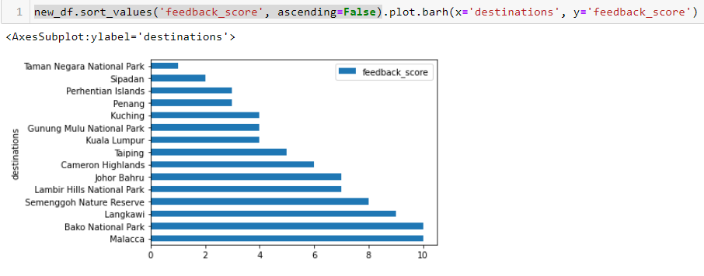
Destinations based on feedback score.

